Slide 1



CBSE AI Practical 2026-27
Pradhumya Singh Yadav | Dhairya Chaudhary | Aryan Chauhan
Jagran Public School Noida
Class: XIIth
01

Slide 2



Diagnostic Gap: The inability of non-specialist health workers to accurately distinguish between complex respiratory sounds leads to high misdiagnosis rates.
₹
Inaccessible Technology: Advanced digital stethoscopes cost upwards of ₹35,000, making AI diagnostic tools unaffordable for local clinics and rural PHCs.
Problem
The "Trial-and-Error" Risk: Local doctors often prescribe generic medication for serious symptoms, wasting critical time while underlying infections like Pneumonia worsen.
Critical Referral Delays: lack of early, objective detection for high-risk conditions results in late-stage hospitalizations and increased mortality in respiratory cases.
02

Slide 3
The Opportunity
Real-time AI classification allows local doctors to identify high-risk pathologies instantly, ensuring life-saving treatment begins days earlier.
Using low-cost, off-the-shelf hardware and open-source AI, this solution can be rapidly deployed across global regions with limited medical resources.
Converting analog breath sounds into digital data enables the creation of a longitudinal health record for better patient monitoring and follow-up.
By reducing the cost of digital stethoscopes by 80%, we can equip every ASHA worker and rural clinic with specialist-level screening tools.

Slide 4
1
VITALIS uses an embedded neural network to instantly translate raw lung sounds into clinical labels like "Normal," "Wheeze," or "Crackle."
2
By utilizing a high-fidelity I2S MEMS microphone, the device captures crystal-clear respiratory data without the electrical noise of traditional analog sensors
Our Idea
3
All AI inference is performed locally on the XIAO C6 microcontroller, ensuring diagnostic results are available in under 6ms without needing an internet connection.
4
The system provides a standardized "second opinion" to local healthcare workers, reducing human error and ensuring high-risk patients are referred to hospitals immediately.
04

Slide 5



SDGS
SDG 3: Good Health and Well-being
SDG 9: Industry, Innovation, and Infrastructure
The Problem: Respiratory diseases are leading causes of mortality in rural areas due to misdiagnosis.
The VITALIS Solution: Providing an automated "second opinion" for lung disease for early detection and timely intervention.
The Problem: Commercial digital stethoscopes are prohibitively expensive
The VITALIS Solution: Utilizes "Edge Computing" via neural networks to provide diagnostic infrastructure with zero INTERNET dependency.
06

Slide 6



Benefits
Prevention of Critical Complications
Elimination of Diagnostic Subjectivity
Enables early detection of high-risk pathologies, allowing for timely hospital referrals and reducing the risk of minor infections turning into emergencies.
Replaces inconsistent human hearing with a standardized AI model, ensuring every patient receives an objective and accurate lung assessment.
Cost-Effective Healthcare Infrastructure
Enhanced Rural Medical Reach
Utilizes affordable, off-the-shelf hardware to provide professional-grade digital stethoscopy at a fraction of the cost of current market alternatives.
Empowers frontline health workers and ASHA volunteers to perform complex diagnostic screenings in remote areas without specialist presence.
06

Slide 7
Says
Thinks
Empathy Map
(Dr.)
"I need diagnostic certainty, not subjective acoustic noise from an analog tube."
"A ₹40,000 digital stethoscope is completely out of my clinic's budget."
"If I miss fluid buildup today, this patient risks severe pneumonia by tomorrow."
"I am forced to rely on auditory guesswork instead of objective medical data.
Does
Feels
Prescribes broad-spectrum antibiotics preemptively to cover diagnostic blind spots.
Delays critical hospital referrals until physical symptoms become severe.
Paralyzed by the clinical liability of a misdiagnosis.
Handicapped by primitive tools in a high-stakes environment.
06

Slide 8
Says
Thinks
"I cannot afford to lose a day's wage traveling 50km to the district hospital for a simple cough."
"The local doctor gave me syrup, but my child is still struggling to breathe."
"I don't have the money for expensive city tests right now."
"Is this just a seasonal cold, or something that will hospitalize me and bankrupt my family?"
"Did the local doctor actually hear what is wrong, or is he just guessing?"
"If I wait a few more days, maybe it will just go away on its own."
Empathy Map
(Patient)
Does
Feels
Ignores early-stage symptoms due to the logistical and financial friction of travel.
Spends out-of-pocket money on generic, ineffective medications that mask the real disease.
Arrives at the emergency room only when the respiratory condition is critical and life-threatening.
Financially anxious about the hidden costs of healthcare and travel.
Vulnerable to misdiagnosis at the local level.
Terrified when their child’s symptoms do not improve after basic treatment.
06

Slide 9
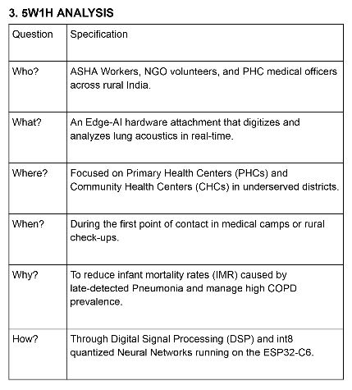
5W1H

Slide 10
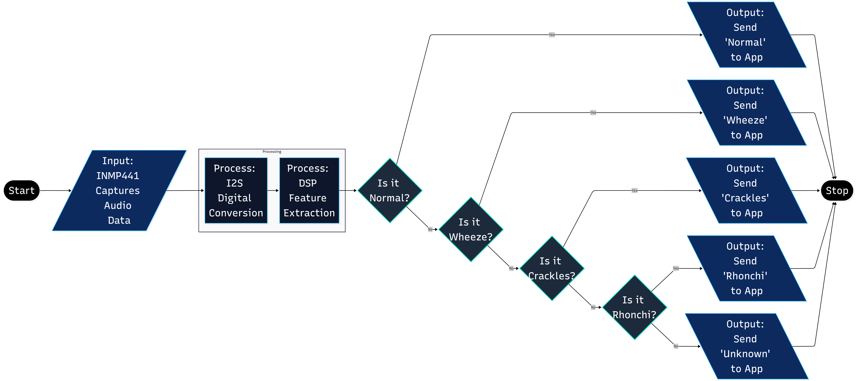
Flow Chart

Slide 11

Prototype Image

Slide 12
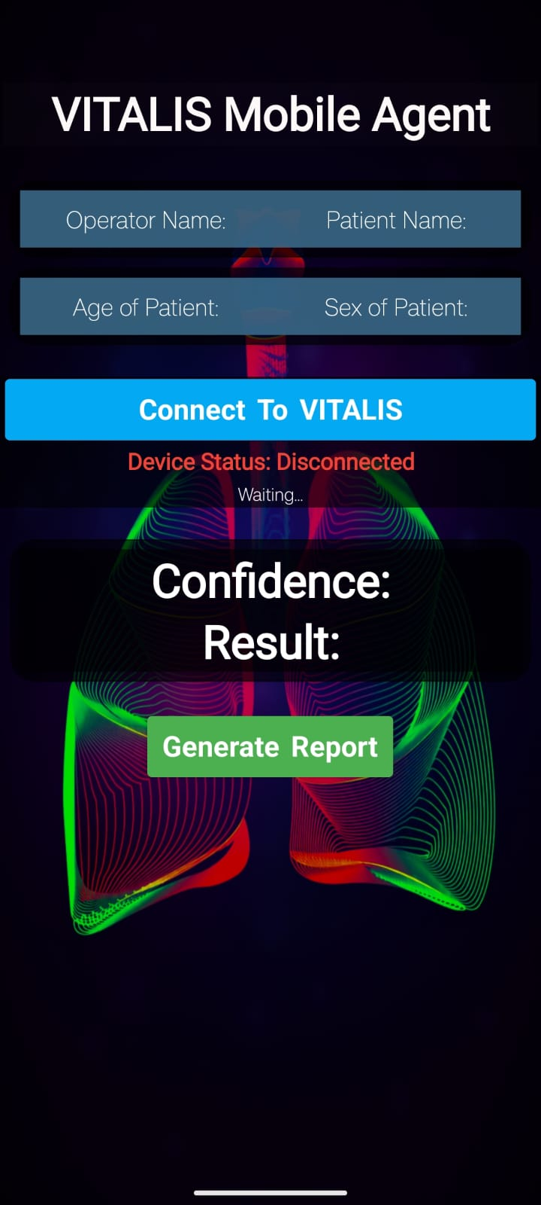
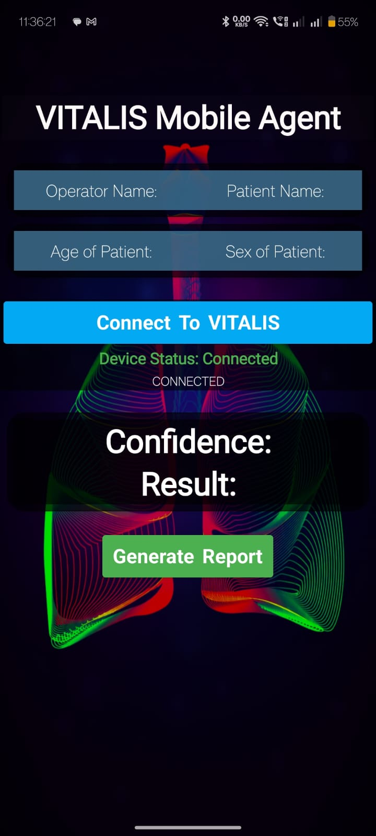
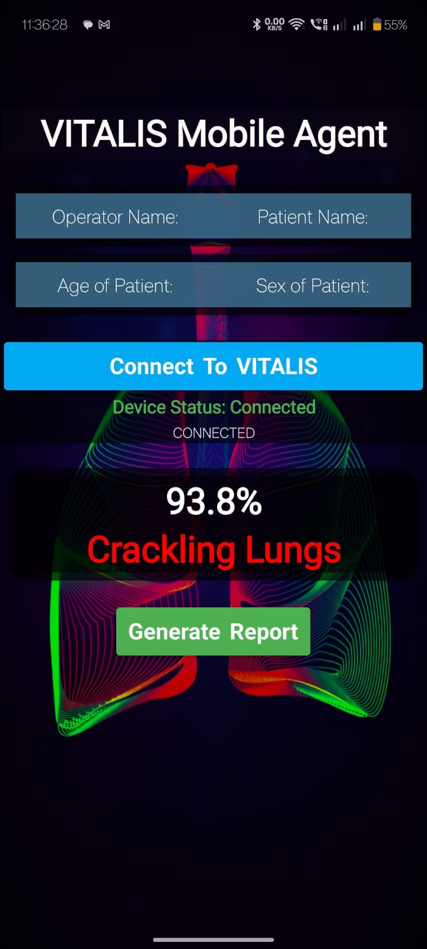
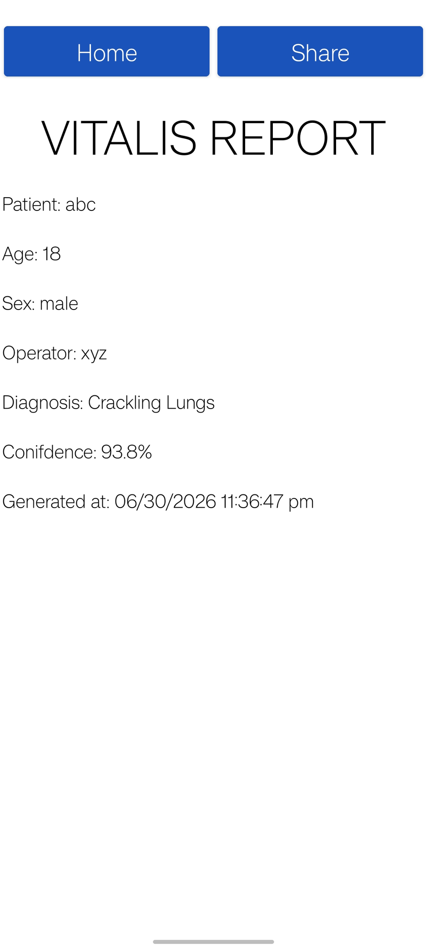


Mobile APP Screenshot
Open The App
Connect To VITALIS
through Bluetooth
Press the Button On
VITALIS to get Results
Generate the Report

Slide 13


